Slide 1
Type Assertions

Slide 2
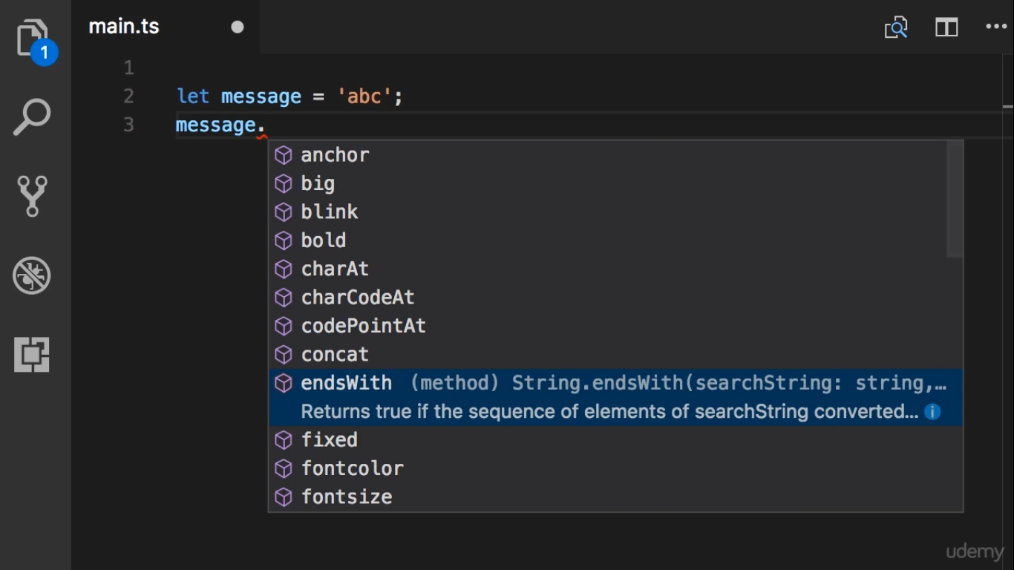

Slide 3
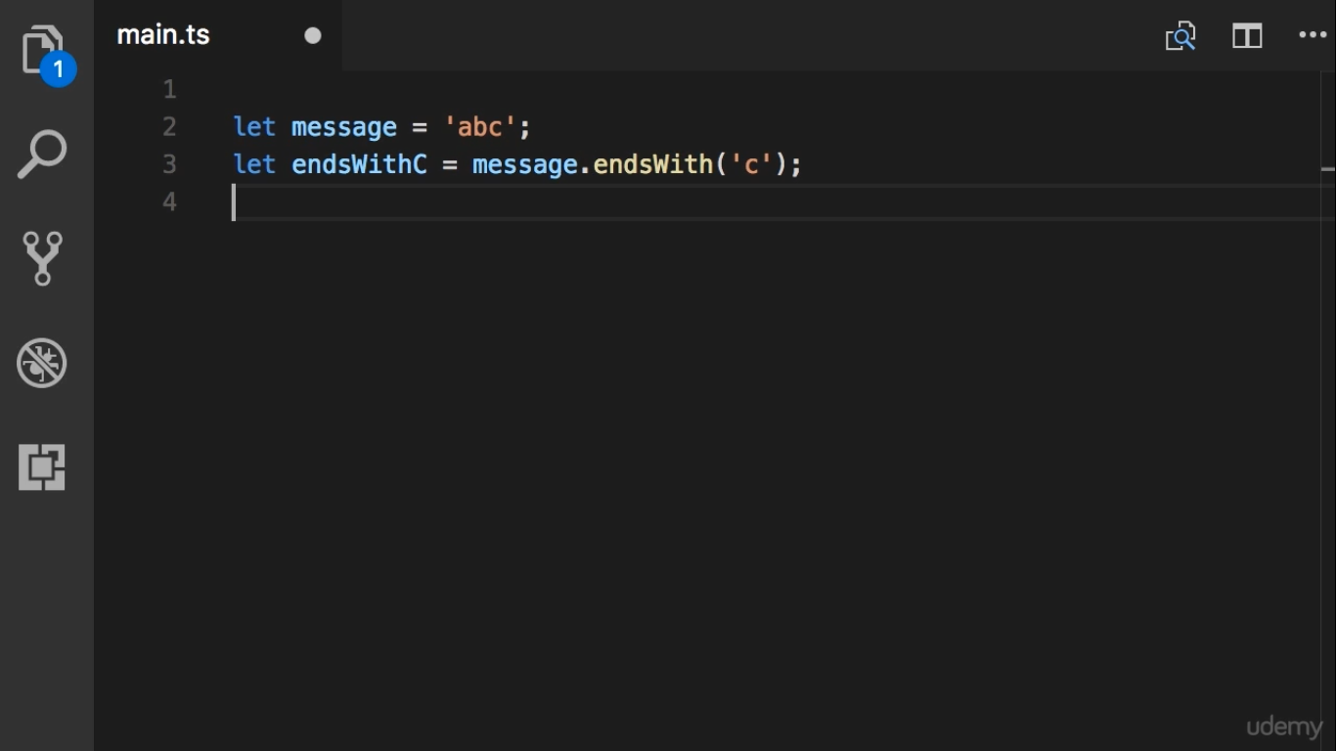

Slide 4
